Slide 1
AI Agent With Python
From ReAct To RAG
(1)

Slide 2
To learn
What Is AI Agent?
AI Agent vs. Agentic AI
Perceive-Reason-Act Loop
AI Agents Architects
Classic Software Vs. AI Agent
Reflex Agent Limitation
LLM As Agent Brain
ReAct
CoT (Chain-of-Thought)
Memory (short-term & long-term)
Function Calling
Knowledge Cutoff and Hallucination
RAG (Retrieval-Augmented Generation)

Slide 3
What is an AI Agent?
suggestion
https://cloud.google.com/discover/what-are-ai-agents

Slide 4

What is an AI Agent?
Definition:
An autonomous system that perceives its environment, reasons, and acts to achieve specific goal
Key traits:
goal-directed, adaptive, continuous loop
Examples:
thermostat, robot vacuum, voice assistant, trading bot

Slide 5
AI Agent vs. Agentic AI
 | AI Agent | Agentic AI
Scope | Single task/focused | Multiple tasks, cross-domain
Decision-making | Rule-based/prescribed | Autonomous, goal-driven
Adaptability | Static, limited learning | Dynamic learning, adapts in real time
Initiative | Waits for input | Takes initiative, plans actions
Complexity | Simple to moderate | Handles complex workflows

Slide 6
AI Agent vs. Agentic AI
Examples
AI Agent: A helpdesk bot that classifies support tickets or provides scripted responses to FAQs.​
Agentic AI: An IT assistant that can interpret user queries, access multiple systems, resolve issues autonomously, and adapt solutions as needs change.
suggestion
https://medium.com/@speaktoharisudhan/ai-agent-vs-agentic-ai-understand-the-actual-difference-4580a4b01dd4

Slide 7
What is an AI engineer?
suggestion
https://www.coursera.org/articles/ai-engineer
Book
AI Engineering: Building Applications with Foundation Models

Slide 8
The Perceive → Reason → Act Loop

Slide 9
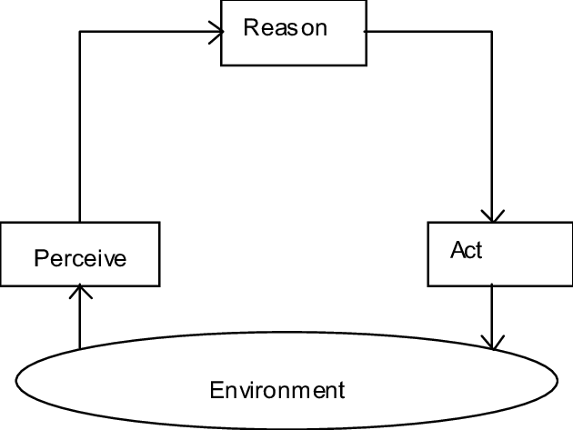
Perceive → Reason → Act
Perceive: read inputs (sensors, text, API data)
Reason: decide a next step (rules, model, LLM)
Act: change the world (turn on heater, reply, call API)
Repeat with new observations

Slide 10
Types of Agents
suggestion
https://www.ibm.com/think/topics/ai-agent-types
https://langchain-ai.github.io/langgraph/concepts/agentic_concepts/

Slide 11
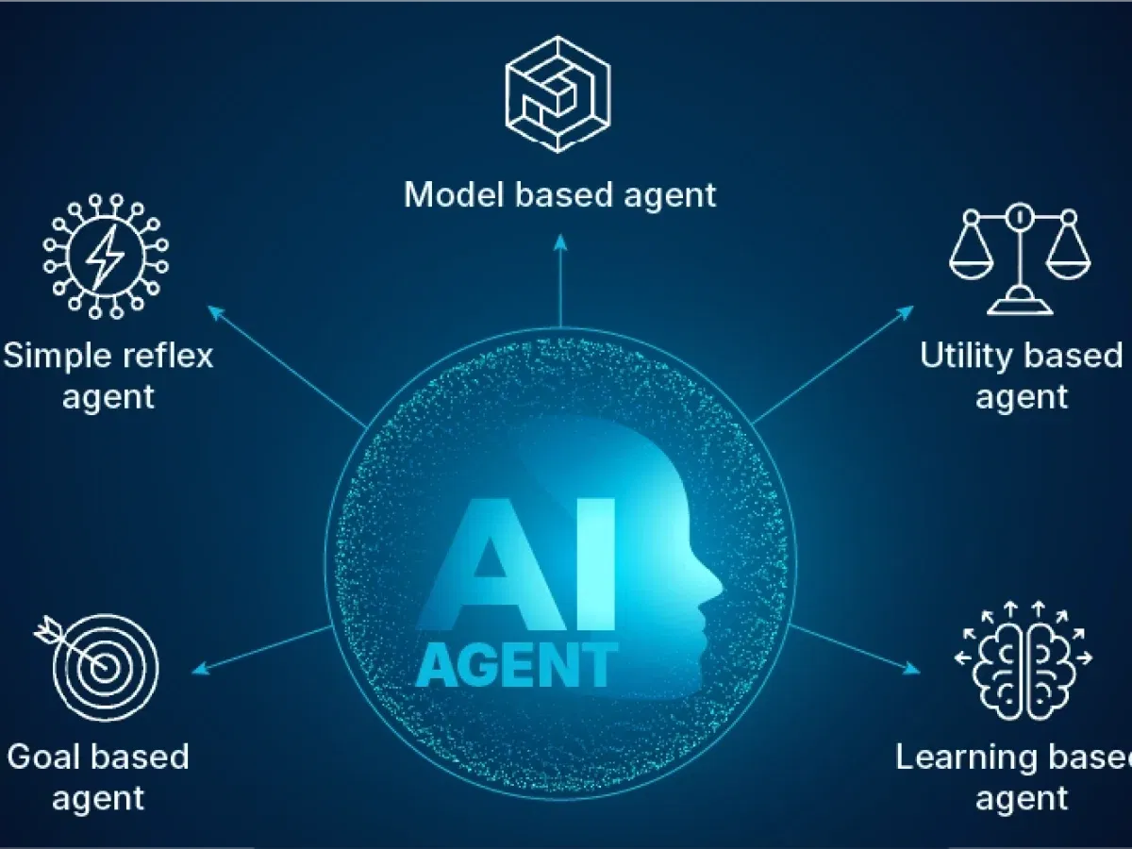
Types of Agents
Simple Reflex: if–then rules (thermostat)
Model-Based Reflex: rules + internal memory (room map)
Goal-Based: plans to reach targets (pathfinding)
Utility-Based: maximizes overall “goodness” (time, energy)
Learning Agent: improves via experience (RL, data)

Slide 12
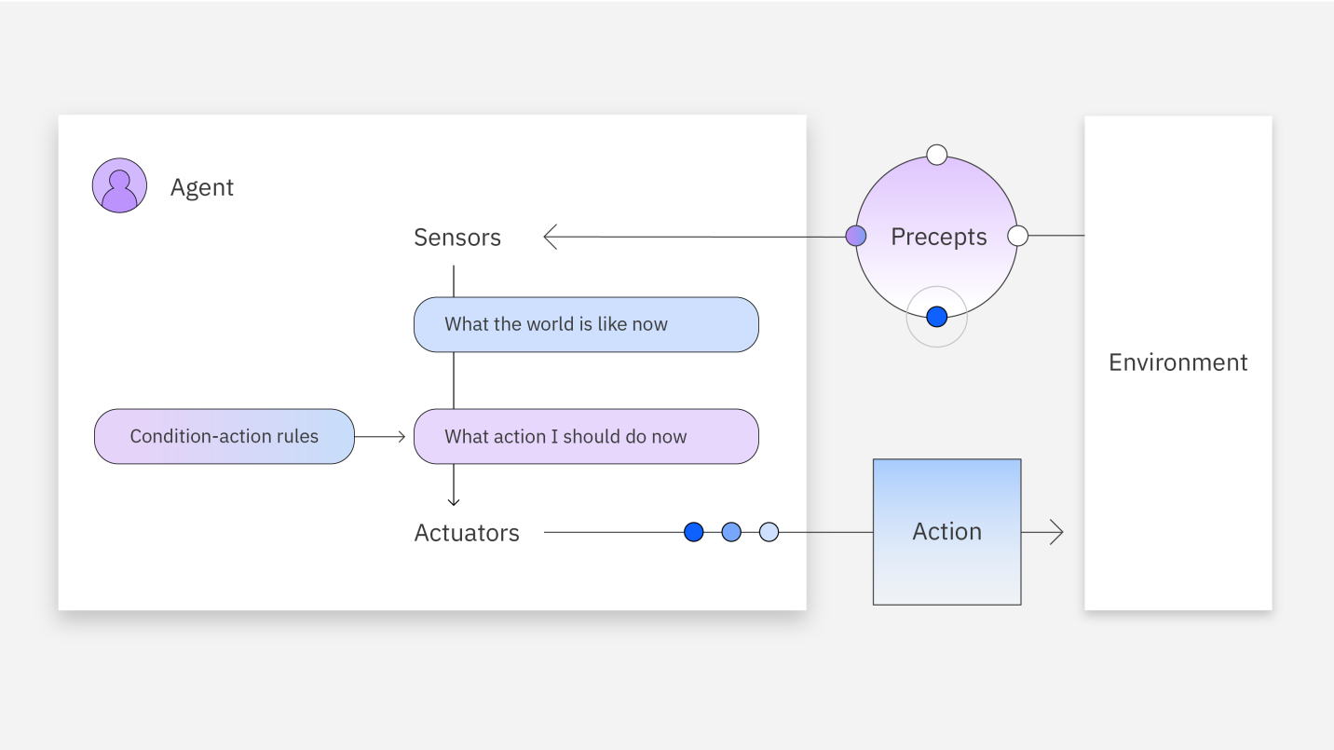
Simple reflex agents

Slide 13
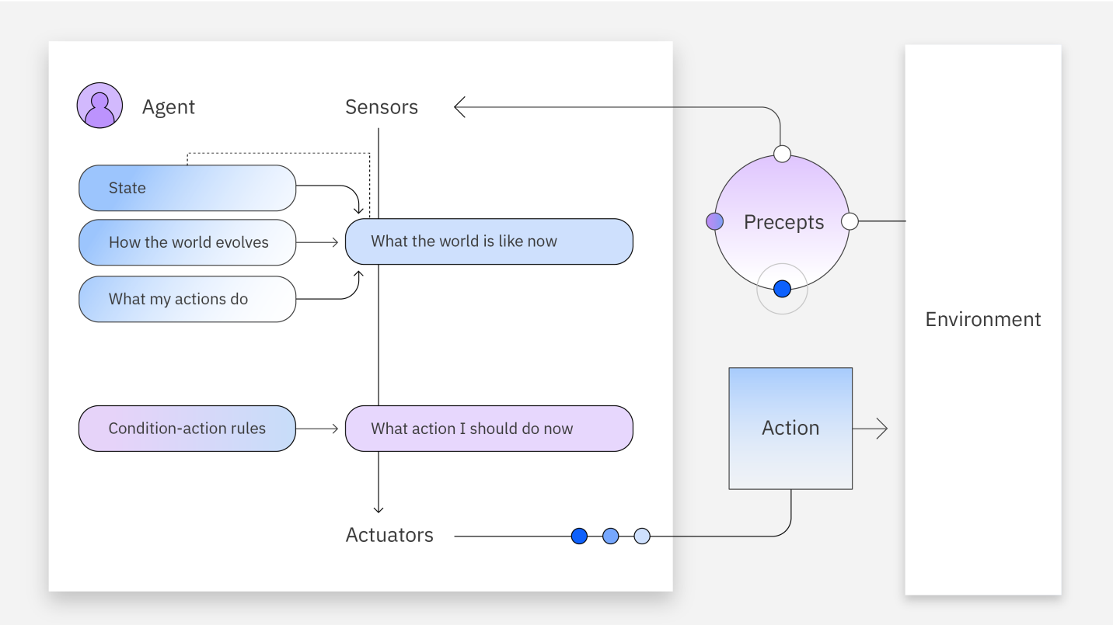
Model-based reflex agents

Slide 14
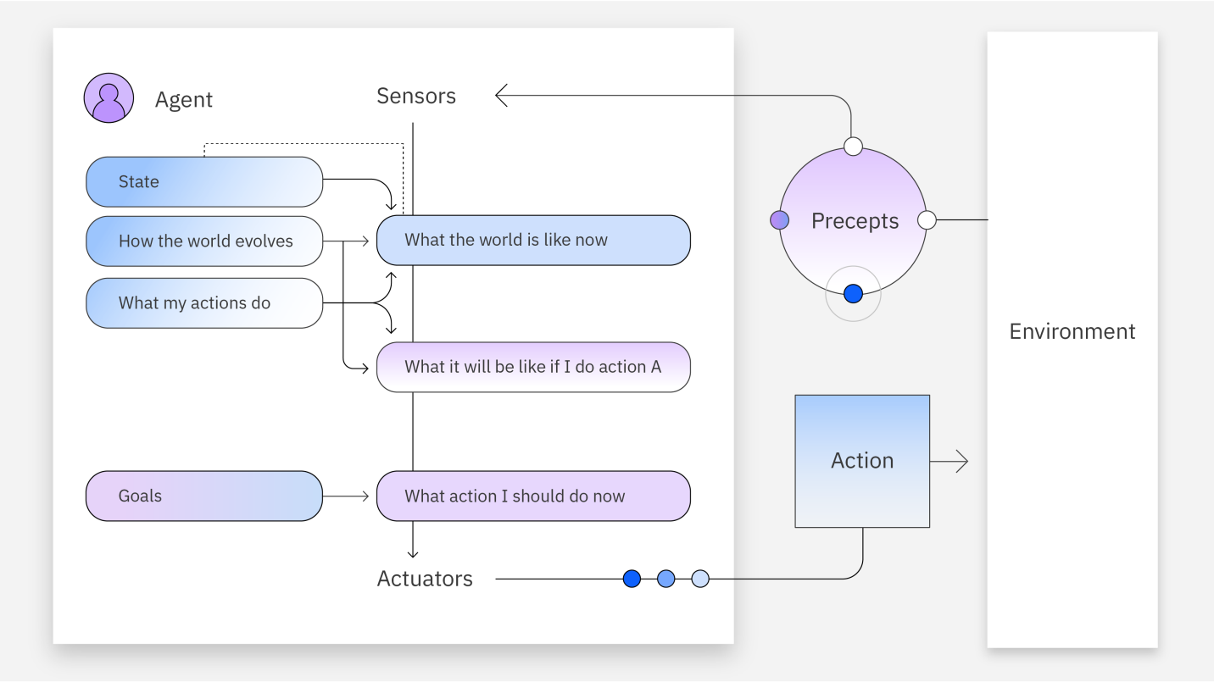
Goal-based agents

Slide 15
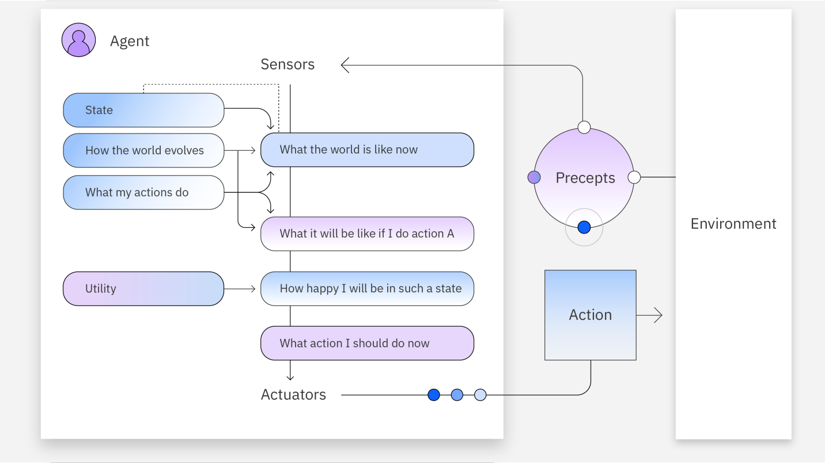
Utility-based agents

Slide 16
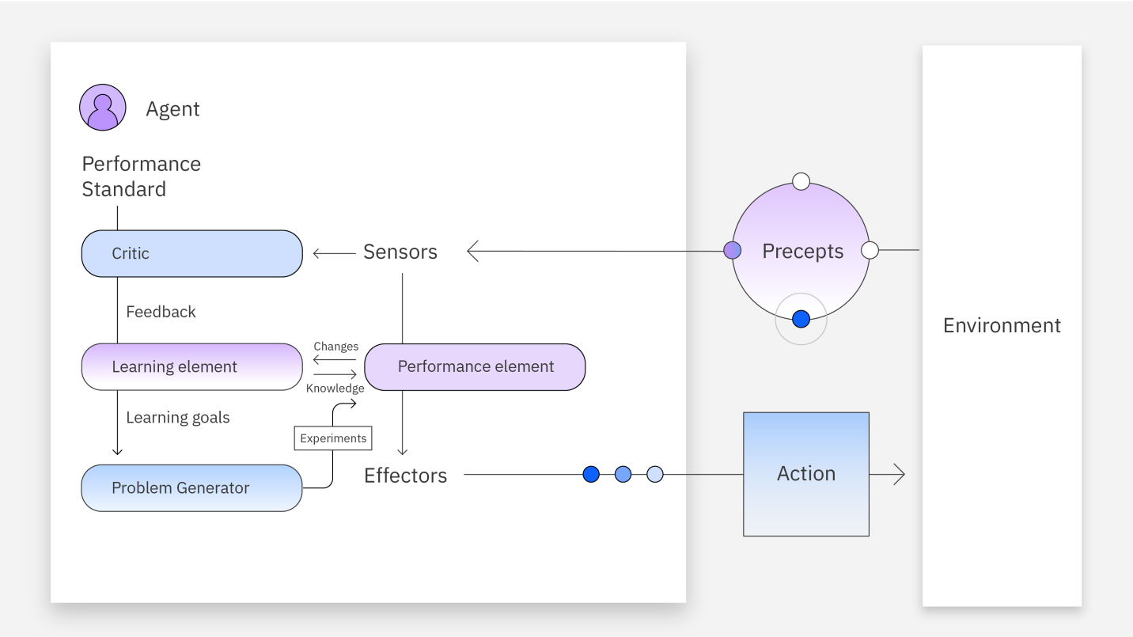
Learning agents

Slide 17
Why Rules Alone Aren’t Enough?

Slide 18
Limits of Rule based Agent
New situations → rules break
Hard to anticipate every case
No learning, no generalization
We need a more flexible brain!

Slide 19
Enter LLMs As The Agent’s Brain

Slide 20

LLM as the Agent’s Brain
LLM (Large Language Model): trained on vast text → understands & generates language
Strengths: broad knowledge, step-by-step reasoning, natural instructions
Paradigm shift: tell what you want (goal), not every how step

Slide 21
LLM vs SLM
Size and model complexity
Contextual understanding and domain specificity
Resource consumption
Bias
Inference speed
Data sets

Slide 22
LLM vs SLM
When it comes to language models, their effectiveness depends on how they're used. LLMs are great for general purpose applications where you want versatility while SLMs are ideal for when you want a model that excels in domains that require efficiency and precision.
suggestion
https://www.splunk.com/en_us/blog/learn/language-models-slm-vs-llm.html

Slide 23
ReAct (Reason + Act)
suggestion
https://www.ibm.com/think/topics/react-agent

Slide 24
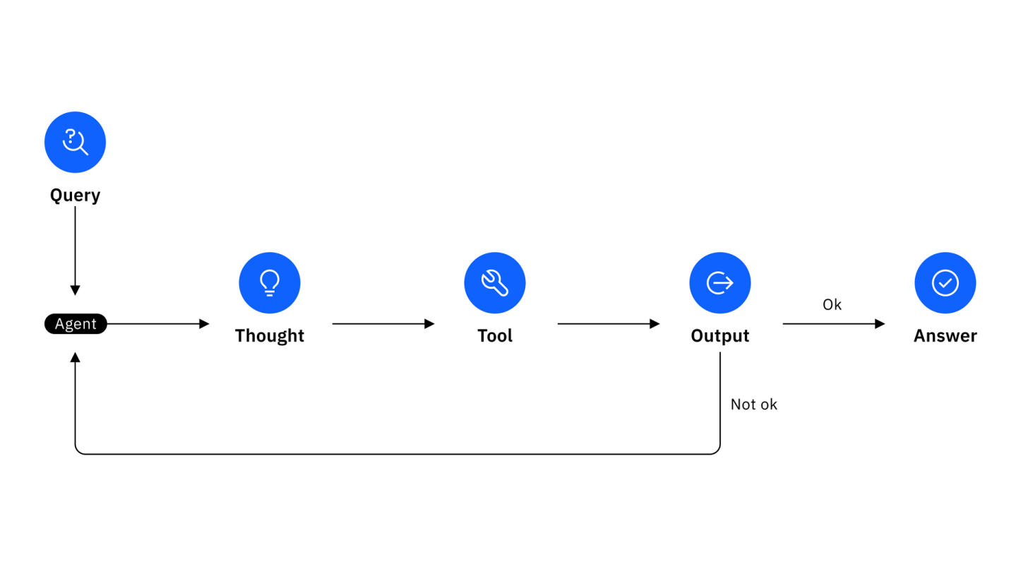
ReAct
Agents think and do in turns
Pattern: Thought → Action → Observation → (repeat)
Use tools when needed; think again with new evidence
Enables multi-step problem solving

Slide 25
Chain-of-Thought (CoT) Prompting (Think Step-by-step)
suggestion
https://www.promptingguide.ai/techniques/cot

Slide 26
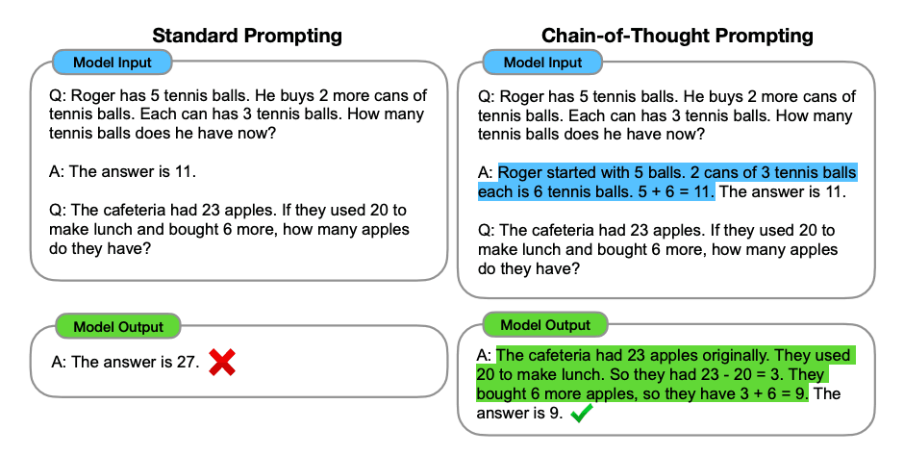
CoT
Prompt the model to explain steps
Improves logic & math answers
Makes reasoning auditable
“Let’s think step by step” is powerful

Slide 27
Memory: Short-term Vs Long-term
suggestion
https://medium.com/@gokcerbelgusen/memory-types-in-agentic-ai-a-breakdown-523c980921ec
https://adasci.org/short-term-vs-long-term-memory-in-ai-agents/

Slide 28
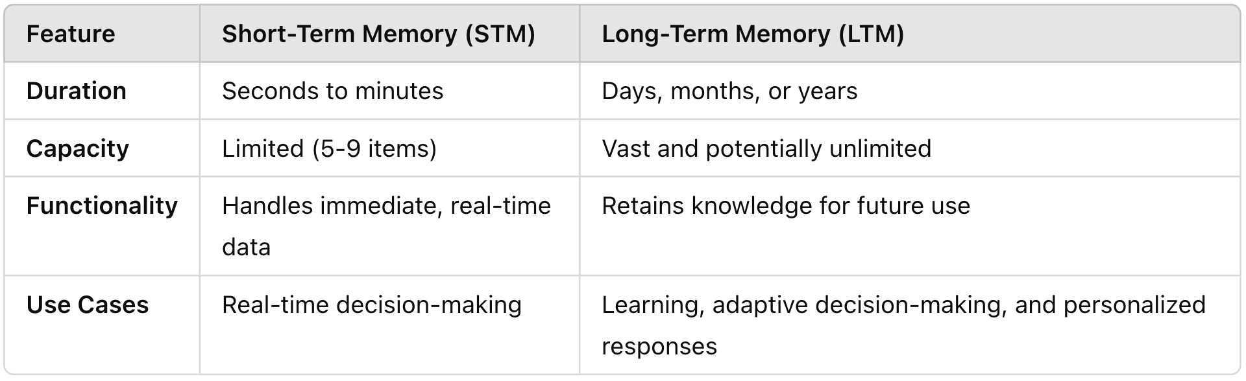
Memory
Short-term: context window (recent messages)
Long-term: external storage (vector DB / notes)
Why it matters: continuity, preferences, history

Slide 29
Tool Use (APIs & Functions)
Suggestion:
medium.com/@teendifferent/decoding-function-calling-in-ai-agents-how-it-really-works-3cbcf77648ec

Slide 30
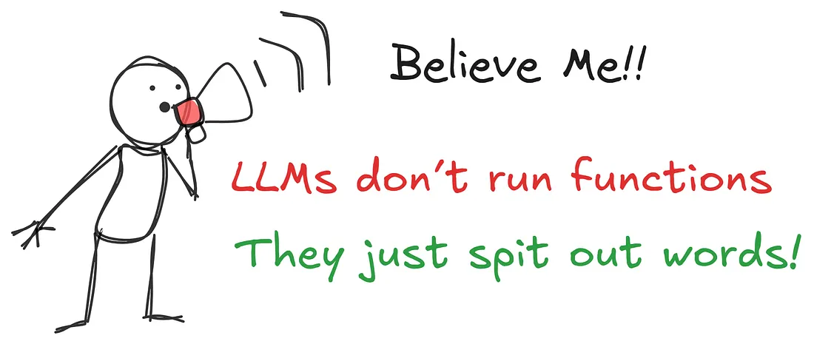
Tool Use
LLMs can’t do everything internally
Tools: search, calculator, calendar, database, custom APIs
Function Calling: model requests a tool with structured args
Result feeds back into the reasoning loop

Slide 31
Next
Function Calling (LangChain)
Knowledge Cutoff and Hallucination
RAG (Retrieval-Augmented Generation)

Slide 32
Thank you

